Slide 1
Growth in early years: statistical and clinical insights
Tim Cole
Population, Policy and Practice Programme
UCL Great Ormond Street Institute of Child Health
London WC1N 1EH
UK

Slide 2
Child growth
Growth is the unique paediatric indicator of well-being, which can monitor a child for endocrine, nutritional, emotional and physical health
Ian Jefferson

Slide 3
How to assess growth
Measure child
Plot on growth chart
Read growth chart
Take action

Slide 4
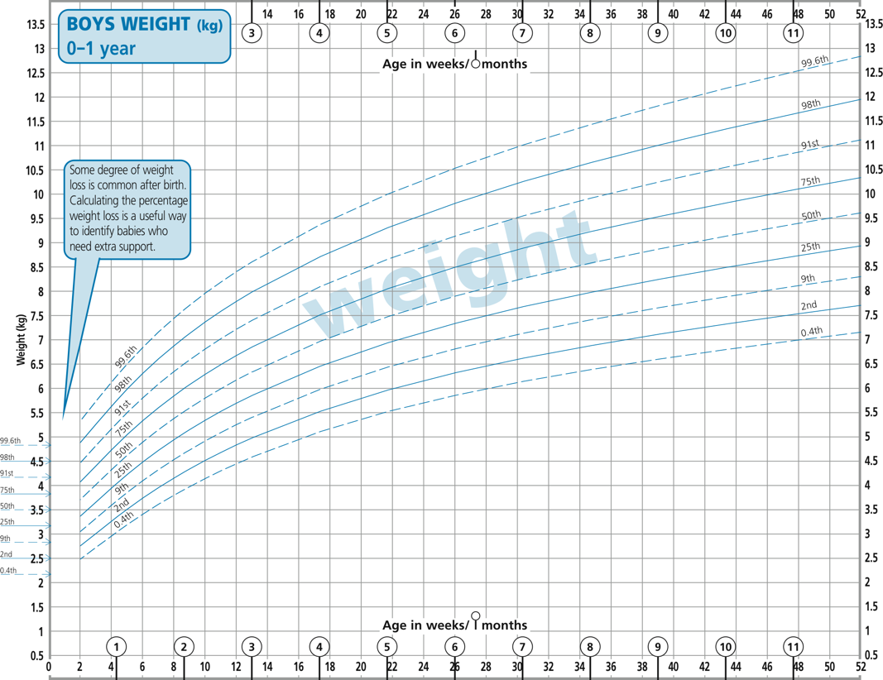
Centiles and centile crossing
99.6
98
91
75
50
25
9
2
0.4
centiles
high centile •
centile tracking
centile crossing up
centile crossing down
• low centile
UK-WHO chart

Slide 5
What is a centile?
Centile - percentage point of the frequency distribution
Cut-off identifies that percentage of children with measurements below it
Examples
50% of children lie below 50th centile (median)
25% of children lie below 25th centile
99.6% of children lie below 99.6th centile (0.4% above)
The cut-offs vary by age, so the centiles appear as curves on the growth chart

Slide 6
Growth distance and velocity
Growth chart is “road to health”
Current size (i.e. centile) indicates distance travelled
Centile crossing indicates velocity of travel
Growth chart quantifies size/distance
Centile
Growth chart does not quantify growth velocity
Centile crossing is uncalibrated
Ironic - growth chart does not measure growth…

Slide 7
A new concept: growth acceleration
Growth distance
One measurement
Centile
Growth velocity
Two measurements
Centile crossing
Growth acceleration
Three measurements
Change in centile crossing

Slide 8
Distance - one measurement
•
•

Slide 9
Velocity – two measurements

Slide 10
Acceleration – three measurements

Slide 11
Growth pattern – many measurements

Slide 12
Growth pattern – many measurements
Modelling growth curves with SITAR
Provides simple summary of individual growth patterns

Slide 13
Aims
To show how statistics helps chart assessment for:
Growth distance
Growth velocity
Growth acceleration
Growth pattern

Slide 14
Growth distance One measurement

Slide 15
Constructing growth charts
Growth charts designed to assess single measurements
Compare measurement to distribution of reference measurements for age and sex
LMS method popular way to construct growth charts
Worked example for weight in girls
Cole TJ, Green PJ. Smoothing reference centile curves: the LMS method and penalized likelihood. Stat Med 1992;11:1305-19.

Slide 16
Constructing growth charts
Weight in 4000 girls
Age 1-21 years
Aim: to define weight distribution at each age
95% below 95th centile
50% below 50th centile
5% below 5th centile
etc

Slide 17
Constructing growth charts
Weight in 4000 girls
Age 1-21 years
Aim: to define weight distribution at each age
Construct smooth centile curves
50% below 50th centile
3% below 3rd centile
97% below 97th centile
etc

Slide 18
LMS method
Cole, JRSS A (1988)
Split into narrow age groups
Summarise distribution in each group
Need to adjust for skewness
Raise weight to Box-Cox power λ
Calculate mean μ and coefficient of variation σ
So λ μ and σ vary by age

Slide 19
LMS method
Plot λ μ and σ against age and fit smooth curves
L curve for Box-Cox power λ
M curve for median μ
S curve for coeff of variation σ
Hence LMS method

Slide 20
LMS method
Centile curves are functions of L M and S curves
So if L M and S curves are smooth, centiles are too

Slide 21
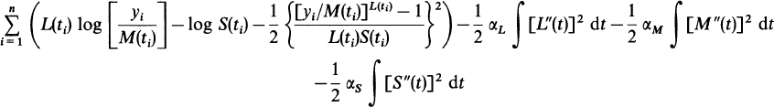

Cole-Green LMS method
Peter Green (1988) proposed using maximum penalized likelihood to improve LMS method
Elegantly avoids arbitrary age groupings
See Cole & Green, Stat Med (1992)
Now the standard method
Peter Green FRS

Slide 22
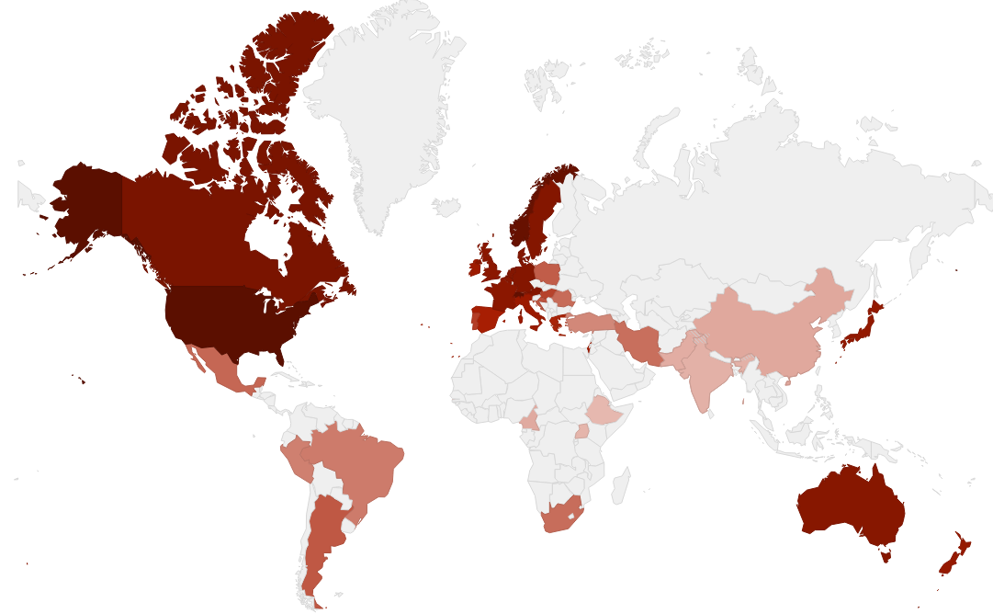
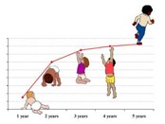
40 countries use LMS method
WHO growth standard

Slide 23
Growth velocity Two measurements

Slide 24
Growth velocity
Velocity appears as centile crossing on chart
Two problems with chart centiles
They assess distance not velocity
Light babies grow faster, heavy babies slower
Regression to the mean
So velocity depends on starting weight
Only experience can tell if centile crossing is abnormal
Need a way to flag abnormal centile crossing on chart

Slide 25
Velocity and centile crossing
Show line on chart whose slope corresponds to 5th velocity centile over 4 weeks
Depends on age and initial centile

Slide 26
Centile crossing over 4 weeks
95
5
95
50
5
95
5

Slide 27
Statistics of centile crossing
Two weights 4 weeks apart
Convert to z-scores z₁ and z₂
Expected mean of z₂ is r.z₁
where r is correlation between z-scores
Conditional SD of z₂ is √1-r²
So 5th centile for z₂ is
z₂ = Mean – 1.64 SD = r.z₁ – 1.64√1-r²
So z₂ depends on z₁ and r

Slide 28
Thrive lines for growth velocity
For ages 0-4, 4-8, 8-12 … weeks
calculate correlations r₀₋₄, r₄₋₈, r₈₋₁₂ etc
Choose baseline value z₀
Then using formula
z₀ > z₄ > z₈ > z₁₂ … defines a curve
Call the curve a thrive line as it defines failure to thrive
Cole TJ. Presenting information on growth distance and conditional velocity in one chart: practical issues of chart design. Stat Med 1998;17:2697-707.

Slide 29
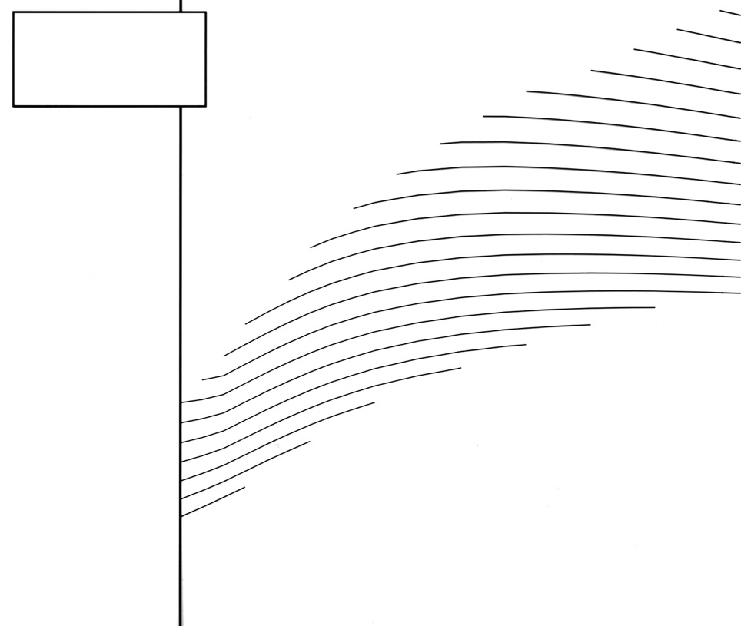
Thrive line overlay - 5th centile weight gain
Boys weight
5th centile for 4-week intervals

Slide 30
Thrive lines
Thrive lines assess weight velocity
5th velocity centile
Over a 4-week period
A child’s plot that tracks along the thrive lines for 4 weeks is growing on the 5th velocity centile
Tracking for longer is worse:
e.g. for 8 weeks, growth < 1st velocity centile
Thrive lines presented as plastic overlay to superimpose on chart

Slide 31
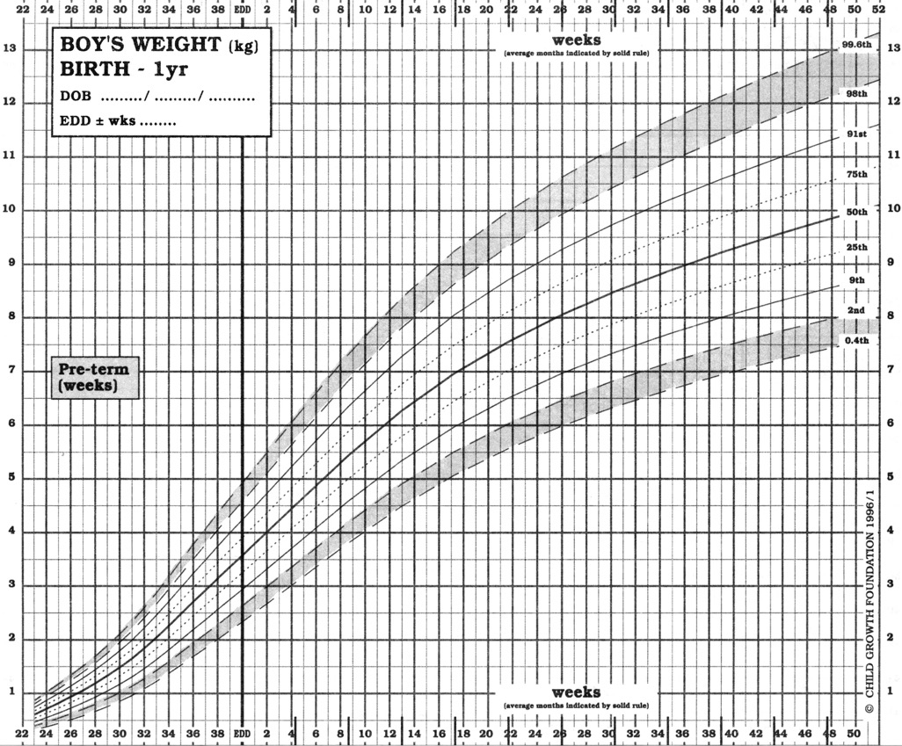
Mild centile crossing - 1 channel width over 8 weeks
•

Slide 32
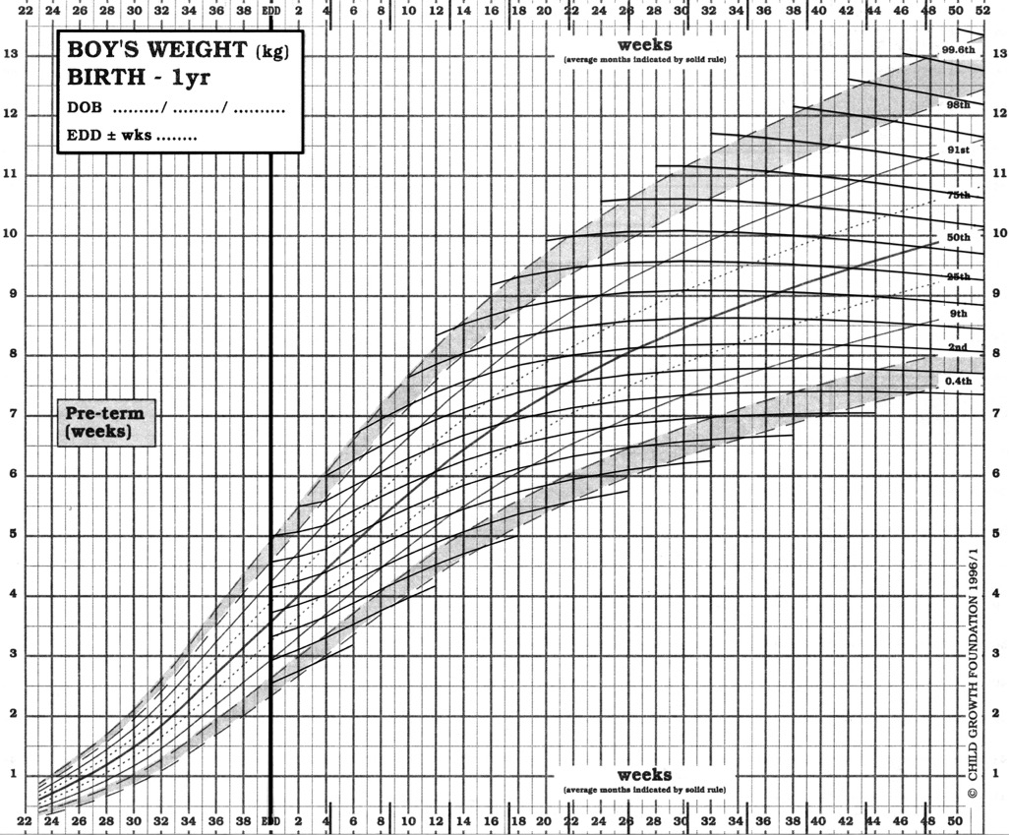
Weight gain above 5th centile
•

Slide 33
Weight gain above 5th centile
•

Slide 34
Moderate centile crossing - 2 channel widths over 8 weeks
•

Slide 35
Weight gain below 5th centile
•

Slide 36
Weight gain below 5th centile
•

Slide 37
Thrive 95 lines
Rapid infant weight gain also a concern
Useful to identify rapid weight gain
Hence “Thrive 95 lines”
Define 95th centile for weight gain

Slide 38
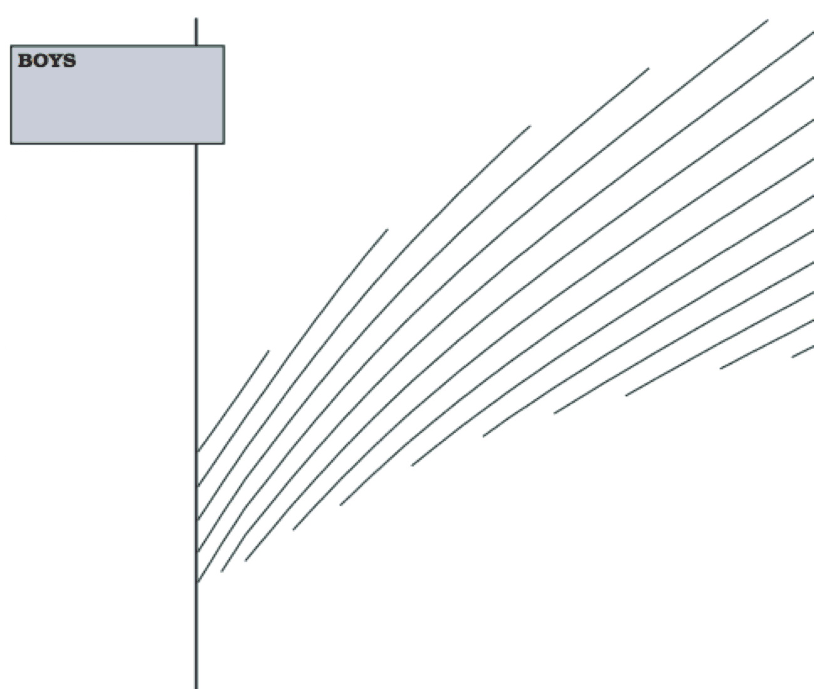
Thrive 95 lines

Slide 41
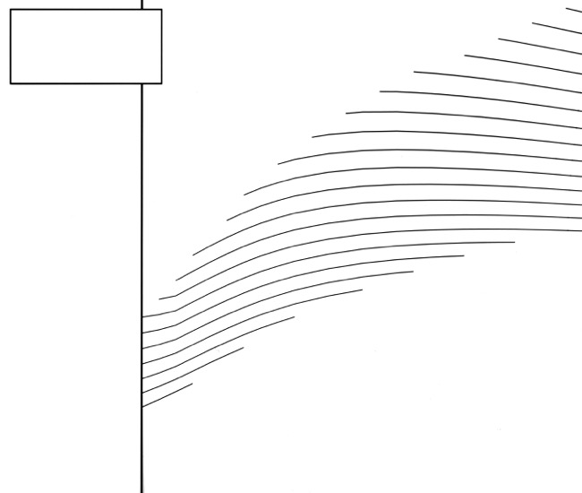
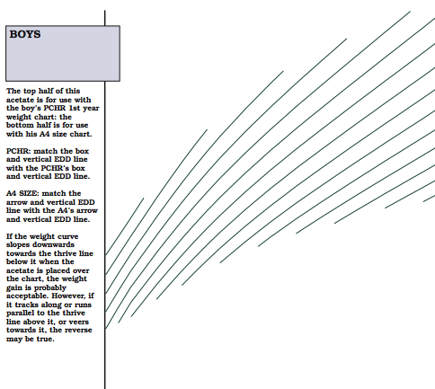
Thrive 5 and Thrive 95 lines
5th centile weight gain
95th centile weight gain

Slide 42
Benefit of thrive lines
Plastic overlay designed to fit on British 1990 chart format
Distance and velocity both assessed yet data plotted just once
No need for separate distance and velocity charts
Useful addition to weight chart

Slide 43
Thrive lines and electronic charts
Now easy to add thrive lines to electronic charts
Thrive lines can be drawn for any required velocity centile, e.g. 1st or 99th
Switch between distance and velocity centiles

Slide 44
Distance centiles
•

Slide 45
Velocity centiles
•

Slide 46
Growth acceleration Three measurements

Slide 47
Question
You observe an infant grow over 4 weeks
They show upward or downward centile crossing
Ask yourself:
“How will they grow over the next 4 weeks?”
Will they stay on the same centile?
Will they continue to cross centiles the same way?
Or will they cross centiles the other way?

Slide 48
Centile crossing over 4 weeks

Slide 49
Statistics of centile crossing and deviation
As before, convert weights to z-scores
The change in z-score over 4 weeks is deviation
e.g. from birth to 4 weeks: Deviation = z₄ – z₀ = d₀₄
Deviation the same as centile crossing
Research question: What is the correlation between successive deviations?
e.g. correlation between d₀₄ and d₄₈
Possible answers: zero, positive or negative

Slide 50
Two growth studies of Cambridge infants
Widdowson Study (1959-65)
1094 infants measured monthly from 0-12 months
Representative of Cambridge infants in ~1960
Weights obtained from child welfare clinics
Cambridge Infant Growth Study (1984-87)
255 infants measured every 4 weeks from 0-52 weeks
Families more selected and of higher social class
Infants weighed by experienced research nurse
In brief, monthly weights in infancy

Slide 51
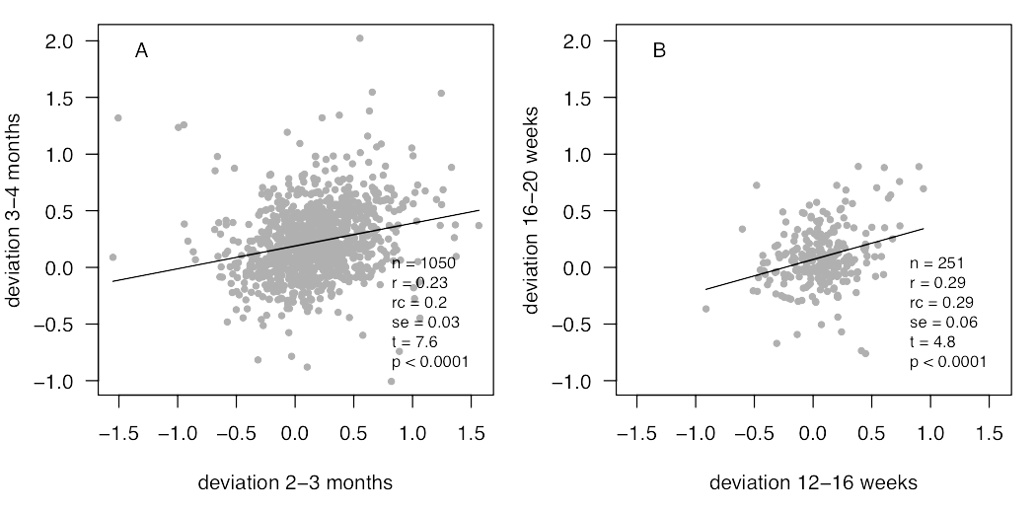
Correlation between successive deviations
Widdowson Study
C I G Study
Age 3-4 months positive correlation

Slide 52
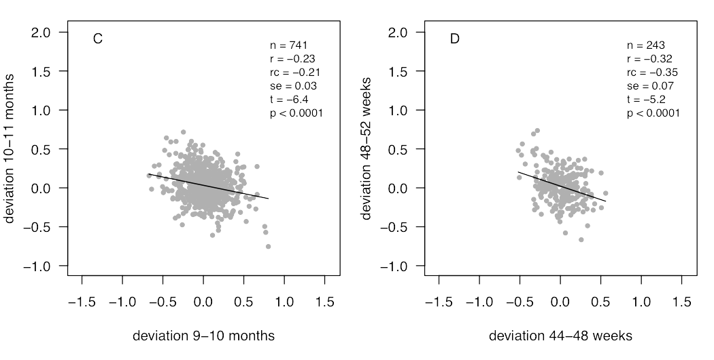
Correlation between successive deviations
Widdowson Study
C I G Study
Age 10-11 months negative correlation

Slide 53
Surprise - deviations are correlated!
At 3-4 months there is a positive correlation
Infants crossing centiles one month are likely to cross centiles in the same direction the next month
At 10-11 months there is a negative correlation
Infants crossing centiles are likely to cross centiles in the opposite direction the next month
Cole TJ, Singhal A, Fewtrell MS, et al. Weight centile crossing in infancy: correlations between successive months show evidence of growth feedback and an infant-child growth transition. Am J Clin Nutr 2016;104:1101-9.

Slide 54
How does the correlation change with age?

Slide 55
Deviation and feedback
Before 6 months infants crossing centiles tend to continue to cross centiles
After 6 months they tend to cross back again
Examples of feedback
Positive feedback before 6 months
Negative feedback after 6 months

Slide 56
Positive feedback
Before 6 months, some young infants want to shift to a different centile
Mismatch between fetal growth and target size?
So need to cross centiles in same direction for a time
But eventually reach their target
Example of positive feedback

Slide 57
Negative feedback
Older infants depart from growth trajectory due to some exposure
e.g. infection leads to downward centile crossing
Response is to compensate the following month
e.g. catch-up following infection
Example of negative feedback

Slide 58
Implications for chart assessment
Centile crossing predicts centile crossing
But depends on age
Early centile crossing (before 6 months)
Expect more centile crossing
Late centile crossing (after 6 months)
Expect reverse centile crossing
Mid-age centile crossing
Expect centile tracking
Easiest to see on weight z-score scale

Slide 59
Growth velocity and growth assessment

Slide 60
Growth acceleration and feedback
Assessment of acceleration a novel idea
Highlights change from positive to negative feedback
Reflects how and why centile crossing becomes less common with increasing age in infancy

Slide 61
Growth pattern Many measurements

Slide 62
Variation in growth pattern
Interesting to look at individual growth curves
To see how they differ, and how they are the same
Here are a sample of growth curves from the Cambridge Infant Growth Study

Slide 71

Summarising growth pattern
Curves largely the same shape
But differing in position
Some high, some low
Some steep, some shallow
SITAR is a growth curve model
that adjusts each curve for being
high/low (size)
early/late (timing)
steep/shallow (intensity)

Slide 72
All growth curves, colour-coded measured every 4 weeks

Slide 73
SITAR
SITAR adjustment makes all curves like the mean curve
High curves shifted down, low curves up (size)
Steep curves made shallower, shallow steeper (intensity)
Early curves shifted later, late curves earlier (timing)
Size, timing and intensity estimated as random effects
Net effect is to superimpose curves
Then fit mean curve through superimposed curves

Slide 74
All growth curves, colour-coded measured every 4 weeks

Slide 75
All growth curves, colour-coded after SITAR adjustment

Slide 76
All growth curves, colour-coded with SITAR mean curve

Slide 77
SITAR growth patterns
SITAR converts growth curves:
to a mean curve:
and a growth pattern for each individual:
size, timing, intensity
Summary like growth distance or growth velocity
SITAR - a useful instrument for growth curve analysis. Cole TJ, Donaldson MD, Ben-Shlomo Y. Int J Epidemiol 2010;39:1558-66.

Slide 78
SITAR growth patterns
SITAR explains over 95% of variance
Very good fit
So random effects define individual growth pattern
Can be used as individual growth summary
To relate to earlier exposures or later life course
BUT note that SITAR not useful clinically
It needs whole growth curve
Comes too late to make clinical decisions

Slide 79
Conclusions
•
Growth summary for one, two, three and many measurements
Distance, velocity, acceleration and pattern
Useful to assess growth in individuals
Improving decision making
Shows how statistics can help in the assessment of growth

